Slide 1
TFS Merging Overview
Development Team Merges
The MOI Process Improvement Team

Slide 2
Why do developers need to Merge?
To work on up-to-date code and detect conflicting changes between the development branches.
To update your ‘Stable’ branch with code changes on the ‘Integration’ branch.
  I.e. to absorb changes from other merges to ‘Integration’ performed by the MOI Config Team.
To update your ‘Stable’ branch with code changes on your ‘Unstable’ branch so that the MOI Config Team can merge these to the ‘Integration’ branch making them available to other branches/teams.
  I.e. from completed (i.e. Integration Testing ready) stories.
To update your ‘Unstable’ branch with code changes on your ‘Stable’ branch.
  I.e. from updates to ‘Unstable’ from ‘Integration’.
NOTE: merges in TFS can only be performed between directly related branches (i.e. parent<->child). That’s a good thing…

Slide 3
When do developers need to Merge?
Integration -> Stable
  Daily – to absorb published (“Done”) changes from other branches.
Stable -> Unstable
  Daily – to absorb published (“Done”) changes from other branches.
Unstable -> Stable
  When stories are ‘Done’.
  Merge all changes on Unstable -> Stable.
Stable -> Integration
  Stop! Only the MOI Config Team do this.

Slide 4
Doing the Merges
One person must be assigned the responsibility for each merge and make sure that it gets completed.
Work with other developers from the same or different teams, and the MOI Config Team, as required, to resolve conflicts.
Do the merging in a separate workspace away from your regular workspaces.
  E.g. in “<your PC>_TFS_MERGE_ADMIN”.

Slide 5
Recommend Merge Set Up
Create a merging specific workspace and matching local directory.
  “<your PC>_TFS_MERGE_ADMIN”.
  Unlike our regular development workspaces we will download more than a single branch to it.
Create a local directory “TFS_MERGE_ADMIN”.
Map the entire MOI TFS project “MOIInternalReleases” to the local directory “TFS_MERGE_ADMIN”.

Slide 6
Recommend Merge Procedure
Switch to the “<your PC>_TFS_MERGE_ADMIN” workspace.
Perform “Get Latest Version” on the source and target branches.
Right-click on the Source branch ->

Slide 7
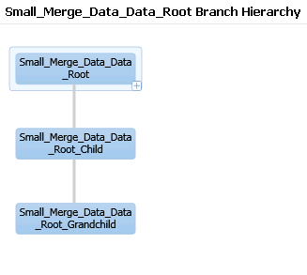
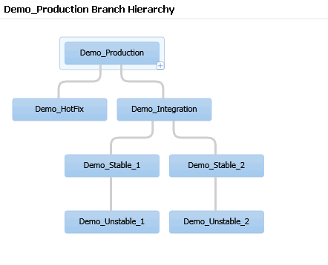
The Demo…
Uses the demo branch hierarchies on the TFS POC server (vmgbstasdt06): -

Slide 8
Demo – an actual merge
Always “Get Latest Version” on source and target branches otherwise you’re merging out of date code – not a problem, but you’re really merging as of a previous time – and, you might well get check in conflicts anyway!
Note that TFS will check out items on the target branch automatically where it needs to update them from the source branch.
Daily merging order: -
  Integration -> Stable
  Stable -> Unstable
Story ‘Done’ merging: -
  Unstable -> Stable (do after daily merging)
NOTE: this demo purposefully has no conflicts to deal with. Notice how simple merging can be!

Slide 9
Thanks, and any Questions?
Please feel free to fire (merge related) questions at us…

